Slide 1
Global Peace Index 2022
Overview & key findings

Slide 2

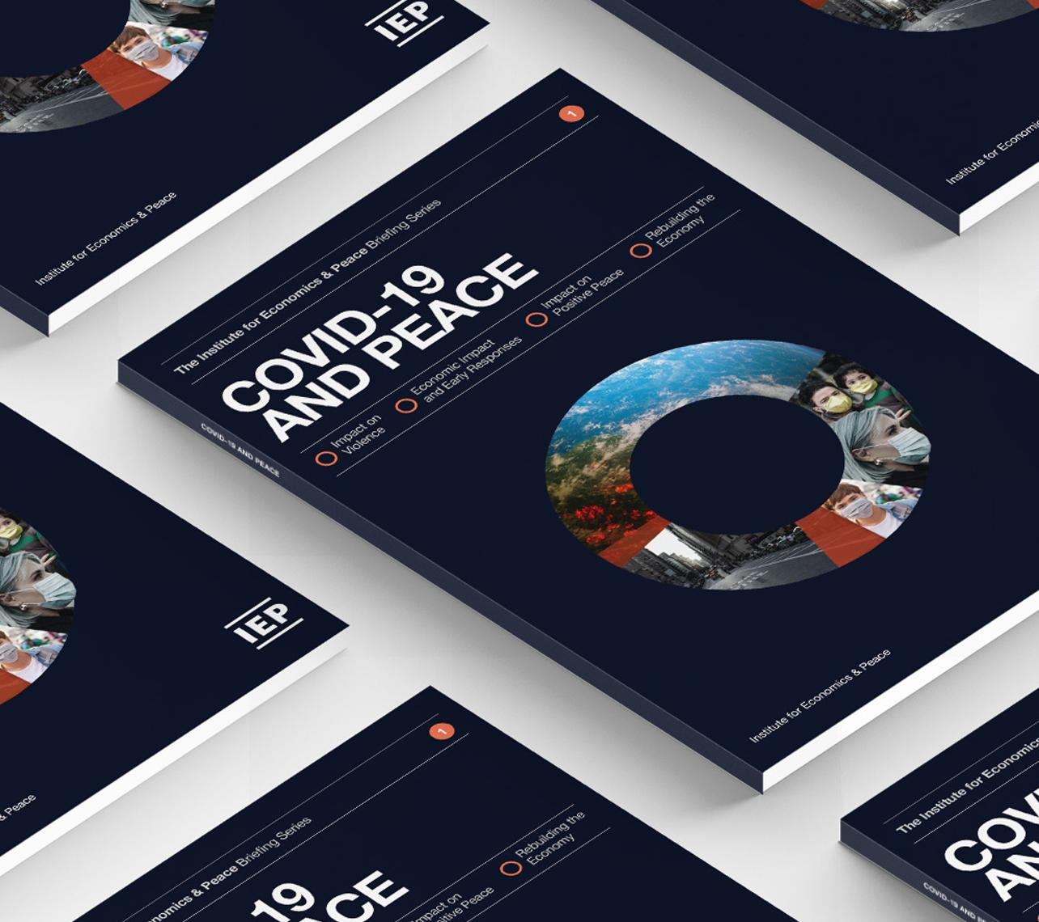
The Institute for Economics and Peace is an independent, not-for-profit think tank dedicated to building a greater understanding of the key drivers of peace, as well as identifying the economic benefits that increased peacefulness can deliver.

Slide 3
Our international offices
Brussels
The Hague
New York
Sydney Head Office
Mexico City
Harare

Slide 4

Institute for Economics and Peace
Research used extensively by organisations, including the OECD, Commonwealth Secretariat, World Bank and the United Nations
27BN
1.3BN
152
MEDIA REACH
SOCIAL REACH
COUNTRY REACH
Work is included in 1,000s of university courses
Over 500,000 downloads of IEP reports in the last 12 months
10
15000
1.4M
PUBLISHED REPORTS
BOOK REFERENCES
WEB VISITORS

Slide 5

Contents
Methodology
Ukraine
Key findings
Trends
Economic value of peace

Slide 6
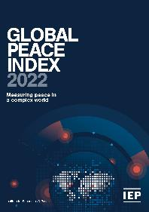
The Global Peace Index
Ranks
Now in its
99.7% of world’s population covered
16th
163
year
countries
Using
Guided and overseen by a panel of International Experts
23
Developed by the Institute for Economics and Peace
Indicators weighed on a 1-5 scale

Slide 7
The Global Peace Index Indicators
6
measures of ongoing domestic and international conflict
10
measures of societal safety
and security
7
measures of militarisation
Including: intensity of organized internal conflicts, relations with neighbouring countries and number of deaths from conflict
Including: number of refugees and IDPs, impact of terrorism, homicide and incarceration rates
Including: military expenditure, number of armed service personnel, ease of access to small weapons

Slide 8
01.
The Impact of the war in Ukraine

Slide 9
Feeling safer than five years earlier, 2019 and 2021
    Between 2019 and 2021, there was a sizable increase in the proportion of Ukrainians feeling safer than five years earlier, while the proportion of Russians declined slightly.

Slide 10
Top risks identified by Ukrainians in 2021
    Only about one in 15 Ukrainians identified “war and terrorism” as their biggest concern.
War and terrorism

Slide 11
“Economy-related” issues as top concern, Russia, 2019 and 2021
    Between 2019 and 2021, the proportion of Russians ranking economy-related issues as their top concern increased nearly threefold.

Slide 12
Life satisfaction and optimism about the future, 2019 and 2021
    Between 2019 and 2021, the percentage of Ukrainians rating their current life conditions and their future prospects as the “best possible” more than doubled.

Slide 13
Capacity of government to deal with a disaster, 2021
    In 2021, only one in five Ukrainians believed their government was well prepared to deal with a disaster.

Slide 14
Impact of the war in Ukraine
The conflict exacerbated the trend of rising food prices, supply chain shortage and rising inflation
Some of the sub-Saharan African nations already struggling with food insecurity and undernourishment have been historically highly reliant on grain supplies from Russia and Ukraine.
NATO members pledges go spend 2% of GDP would increase their military expenditure by 7%
Social media is changing the way intelligence is gathered - Intelligence is shared instantaneously, raw and with little analysis.

Slide 15
Global Military Expenditure
    Military expenditure had been increasing in nominal terms over the past decade. However, relative to GDP, expenditure declined from 4 per cent in the 1980s to 2 per cent in recent years.

Slide 16
NATO Military Expenditure
    If all NATO members comply with the bloc’s minimum required threshold of military expenditure of 2 per cent of GDP, the bloc’s military expenditure would increase by 7 per cent, or $83 billion, from 2021 levels.

Slide 17
Military Expenditure – Global Trends
    If global spend rises according to the expected rise among NATO members, military expenditure could rise to 2.17 per cent of GDP. This would be twice the size of the increase recorded from 2014 to 2021.

Slide 18
Global Military Expenditure - Europe
    Military expenditure in Europe rose relative to GDP in recent years.

Slide 19
Global Military Expenditure – United States
    The US has pledged an increase in spending for 2022

Slide 20
Global Military Expenditure - Germany
    To meet the NATO recommended threshold, German military spending would have to increase by twice the amount of the increase recorded from 2019 to 2020

Slide 21
Global Military Expenditure - UK
    The UK is already above NATO’s minimum spending threshold

Slide 22
Global Food Prices
    The War in Ukraine exacerbated a trend increase in food prices that had already started in 2021, as a result of the lockdowns, supply chain disruptions and quantitative easing.

Slide 23
Undernourishment
    Higher food prices will accelerate the rise in the number of undernourished persons.

Slide 24
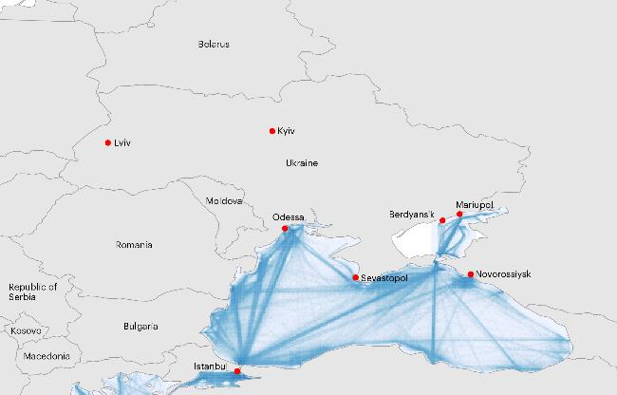
Global Logistic Lines
    The war disrupted supply lines in the Black Sea. Ukraine ships 98 per cent of its grains for exports through its seaports. Blue lines indicate shipping routes.

Slide 25
02.
Key
Findings

Slide 26
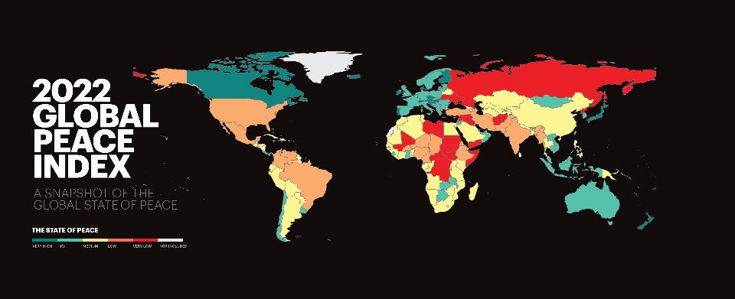
Global Peace Index 2022

Slide 27


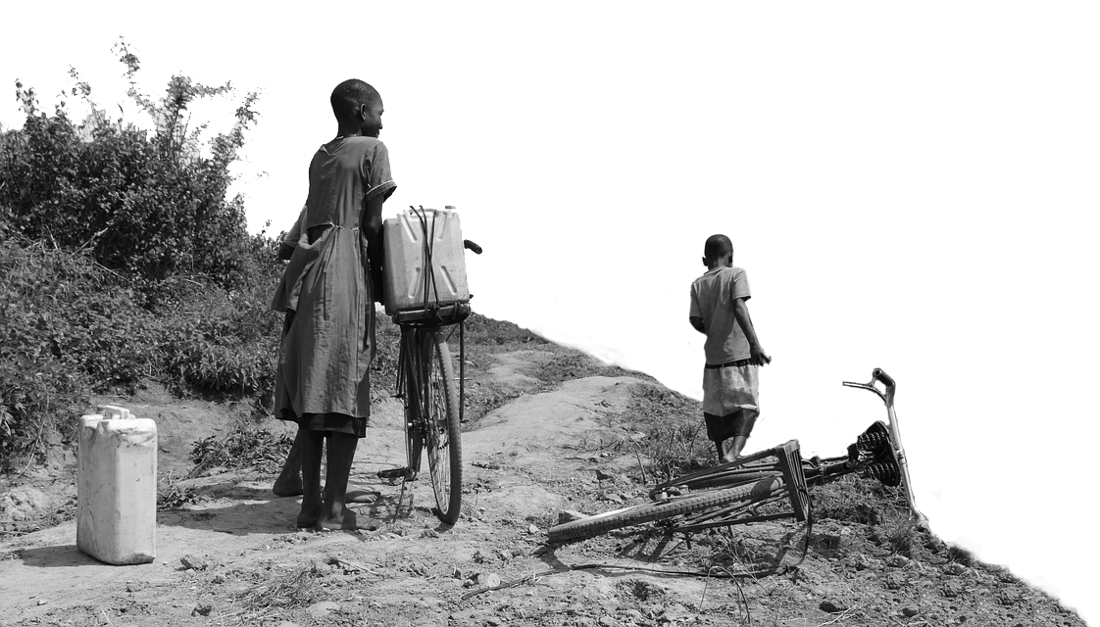
State of Peace in 2022
    The average level of global country peacefulness has deteriorated by
    90
    countries became more peaceful
0.3%
    71
    countries deteriorated
    This is the eleventh deterioration in the last 14 years.
    Improvements were driven by changes in:
    Terrorism Impact
    Incarceration rates
    Military expenditure (% of GDP)
    Deteriorations primarily driven by changes in:
        Refugees and IDPs
        Political Terror Scale
    Neighbouring Countries Relations

Slide 28


2022 key findings
    Iceland remains as the most peaceful country in the world, Afghanistan the least.
    Peace lowest since inception of GPI – down 3.2%.
    Ukraine biggest deterioration, Russia 4th least peaceful country.
    Worst scores since inception of GPI – political terror scale, political instability, neighbouring country relations, refugees and IDPs.
    Inflation, food crisis, supply chain issues and economic conditions likely to fuel further deteriorations in peace.

Slide 29
2021 key findings - continued
    Militarisation improved last year and for last 14 years – 113 improved
    Underlying measures of resilience deteriorating – corruption, group grievances, fractionalised elites and quality of information
    Violent demonstrations deteriorate by 49% since 2008 – 126 countries, only 22 improve
    Global impact of violence $16.5 trillion – 10.9% of global GDP
War is devastating on global economy – hard to win

Slide 30
10 most peaceful countries
1
ICELAND
Rank change:
6
PORTUGAL
Rank change: 1
2
NEW ZEALAND
Rank change:
7
SLOVENIA
Rank change: 3
3
IRELAND
Rank change: 3
8
CZECH REPUBLIC
Rank change: 1
4
DENMARK
Rank change: 1
9
SINGAPORE
Rank change: 1
5
AUSTRIA
Rank change: 2
10
JAPAN
Rank change: 1

Slide 31
10 least peaceful countries
163
AFGHANISTAN
Rank change:
158
CONGO, DRC
Rank change: 1
162
YEMEN
Rank change:
157
IRAQ
Rank change: 2
161
SYRIA
Rank change:
156
SOMALIA
Rank change: 2
160
RUSSIA
Rank change: 5
155
CENTRAL AFRICAN REPUBLIC
Rank change: 1
159
SOUTH SUDAN
Rank change: 1
154
SUDAN
Rank change: 2

Slide 32

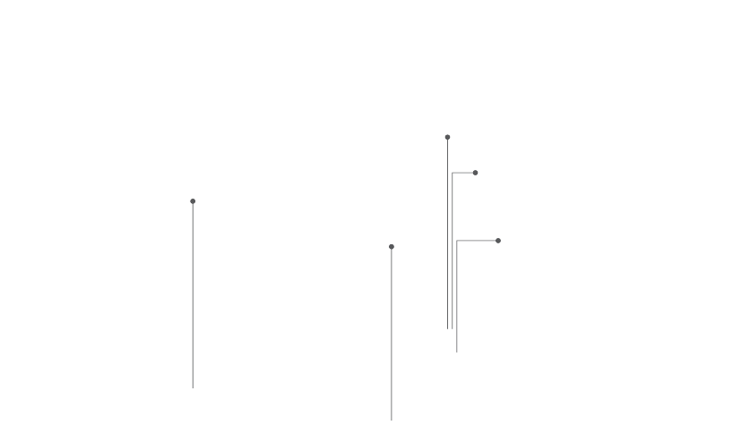
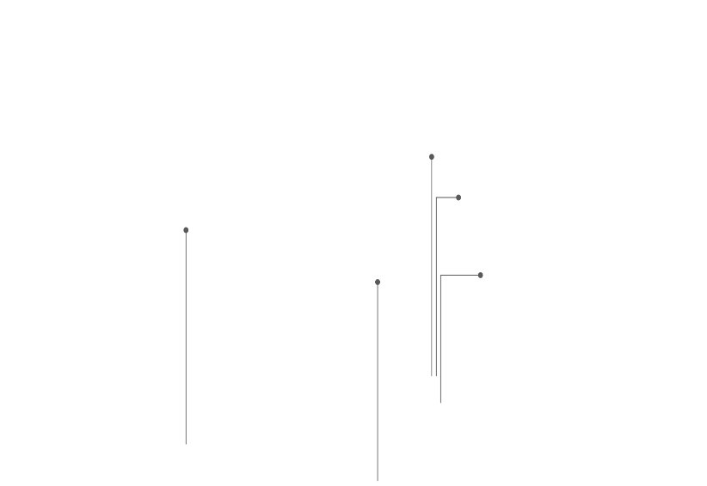
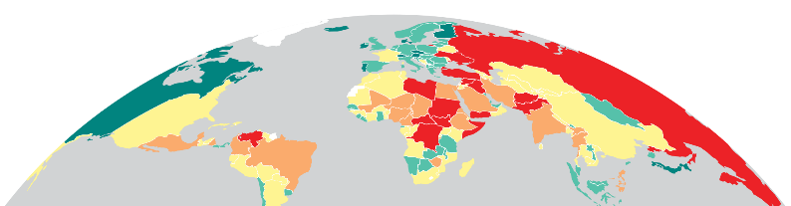
5 most improved countries
LIBYA
EGYPT
RANK: 151
RANK: 126
Rose 5 places
Rose 5 places
SAUDI ARABIA
RANK: 119
ALGERIA
Rose 8 places
RANK: 109
Rose 10 places
PHILIPPINES
RANK: 125
Rose 4 places

Slide 33
5 most deteriorated countries
UKRAINE
RANK: 153
Fell 17 places
GUINEA
RANK: 123
Fell 26 places
BURKINA FASO
HAITI
RANK: 146
RANK: 115
Fell 12 places
Fell 16 places
RUSSIA
RANK: 160
Fell 5 places

Slide 34
03.
Trends in
Peace

Slide 35
Peace since 2008
    Peacefulness has declined year on year for eleven of the last 14 years.

Slide 36
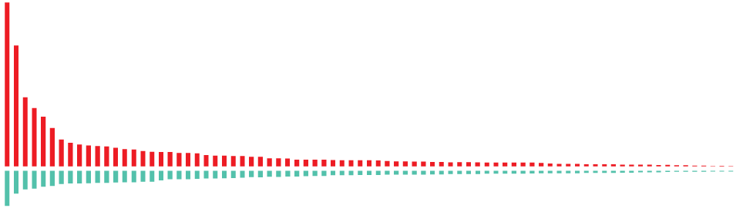
Improvements and deteriorations, 2008-2022
    84
    countries became less peaceful
Peace declined
3.18%
Since 2008
    77
    countries became more peaceful

Slide 37
Peace in the last decade
    Militarisation was the only domain to improve since 2008. Ongoing conflict deteriorated substantially since the mid 2010s.

Slide 38
Rising inequality in Global Peace
    The gap between the least and most peaceful countries continues to grow. The average score for the 25 least peaceful nations deteriorated by 16 per cent, while the score for the most peaceful improved.

Slide 39
Changes in indicator scores 2008-2022
    Violent demonstrations have increased by 49 per cent since the inception of the GPI.
←More Peaceful
Less Peaceful→

Slide 40
Trends in key Safety and Security indicators
Violent Demonstrations recorded the largest deterioration of all indicators
Over 88 million people have now been forcibly displaced by violence
The average global homicide rate fell over the past decade
Source: ACLED; IEP
Source: UNHCR
Source: UNODC

Slide 41
Trends in key Ongoing Conflict indicators
Battle Deaths continue to fall after peaking in 2017
Internal conflicts reached their worse level since the inception of the index
Source: UCDP
Source: UCDP
Source: EIU

Slide 42
Trends in key Militarisation indicators
The fall in the size of armed forces now appears to be levelling off
Despite high spending by global superpowers, average military expenditure has declined in the decade
Weapons imports have improved moderately since 2012
Source: Military Balance+
Source: Military Balance+
Source: SIPRI

Slide 43
Trends in Violent Demonstrations
Violent Demonstrations have been increasing in intensity and lethality throughout the decade

Slide 44
Trends in Violent Demonstrations
Violent Demonstrations deteriorate by 49% since 2008

Slide 45
Trends in Violent Demonstrations
MENA was the only region not to record a large deterioration since 2008, despite the upheaval of the Arab Spring in 2011.

Slide 46
Trends in Violent Demonstrations
All three regions recorded strong deteriorations over the past decade: Central America and the Caribbean, Asia-Pacific and Russia and Eurasia.

Slide 47
Trends in Violent Demonstrations
South Asia has recorded the sharpest deterioration in violent demonstrations of all regions in percentage points.

Slide 48
Trends in Violent Demonstrations
Despite recording a sharp deterioration in 2020 and 2021, the violent demonstrations indicator in full democracies remains at better levels than any other type of regime.

Slide 49
04.
The Economic
Value of Peace

Slide 50
The economic impact of violence 2021
$16.5
trillion
Which is equivalent to
10.9%
of total world GDP
OR
$2117
per person
If the world decreased
violence by 10%...
$1.65 TRILLION
Could be directed to
other economic activities

Slide 51
Economic impact of violence - Highlights
The global economic impact of violence costs $2,117 per person – 52 countries have less per capita income
The economic impact increased by 12.4 per cent
In the ten countries most affected by violence – average cost was 34% of GDP
In the ten most peaceful countries the average economic cost was 3.6% of GDP
If NATO countries meet their 2% of GDP pledge then NATO military expenditure will rise 7%

Slide 52
Breakdown of the economic impact of violence
    Military expenditure accounts for over 46.7 per cent of the total economic impact of violence.
Source: IEP

Slide 53
Economic Impact of Violence
    The global economic impact of violence has increased since 2015.

Slide 54
Composition of Economic Impact by Region
    Security spending has the largest economic impact in most regions

Slide 55



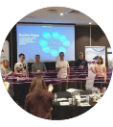

Get involved with IEP
@GlobPeaceIndex
GlobalPeaceIndex
Ambassador Program
Positive Peace Workshops
@GlobalPeaceIndex
Online
Strategic Partnerships
IEP Peace Academy
visionofhumanity.org

Slide 56
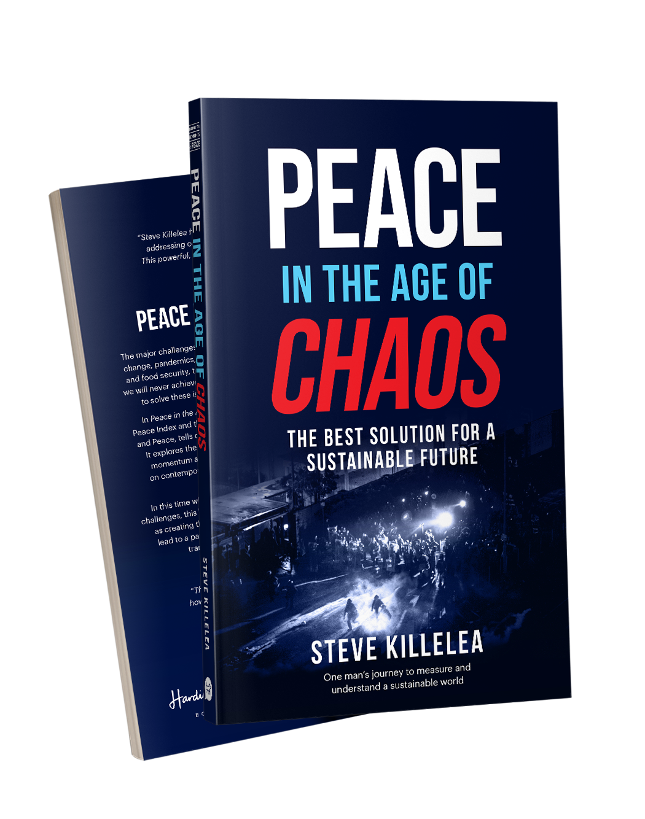
Peace in the Age of Chaos
Peace in the Age of Chaos is the debut
book by the Founder & Executive Chairman
of IEP, Steve Killelea A.M.
The book pushes the reader to rethink peace,
as something that is pivotal to the development of successful societies
Includes many personal experiences and the journey behind the founding of IEP and the Global Peace Index
Endorsed by prominent politicians,
peacebuilders and professors
Buy and more info: peaceintheageofchaos.org

